Slide 1
MEGA PROJECT 2019 - ANSHUMAN SRIVASTAVA
AIM:
TO OBTAIN THE AVG TEMPERATURE PREDICTION FOR YEAR 2019 USING LINEAR REGRESSION

Slide 2
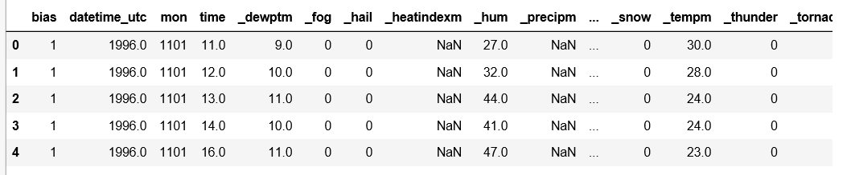
1.LIBRARIES AND DATASET
Libraries used : numpy, pandas, matplotlib,sklearn
Link for the dataset :
https://www.kaggle.com/mahirkukreja/delhi-weather-data#testset.csv

Slide 3
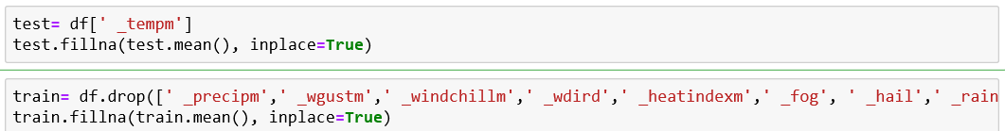
2.DATA PREPROCESSING
PROBLEMS FACED:
Date and Time joined together
(Using Excel Deliminater to split the columns as year and months)
Unnecessary features
(Dropping the columns where most of entries are Nan with pandas)
Nan values
Very Large values for some features
(Used Feature Scaling)

Slide 4
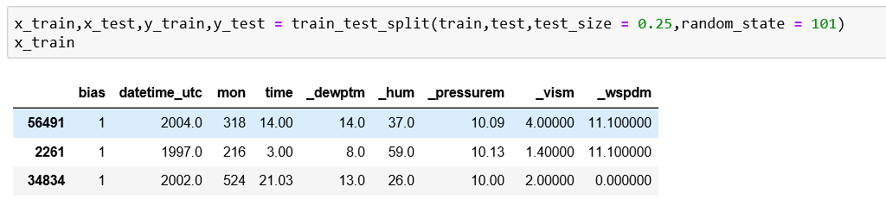
3.TRAINING AND TESTING
Using train-test split made 75-25 split for training and testing data
Here we are taking temperature as y_test label

Slide 5
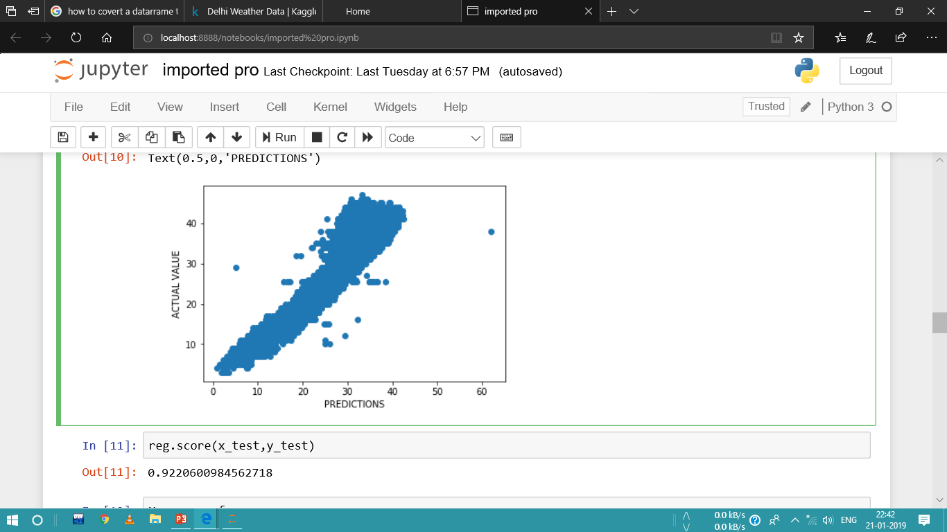
Continued…
Imported Linear Regression from sklearn and fitted the trained parameters to our test set.
Further checking the accuracy obtained as 92.20%

Slide 6
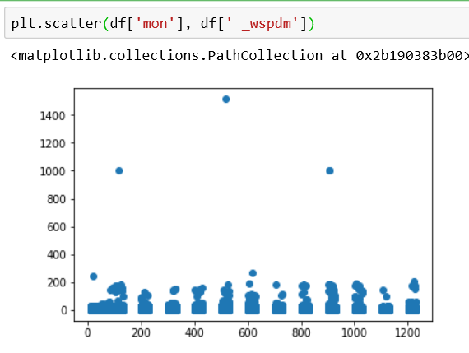
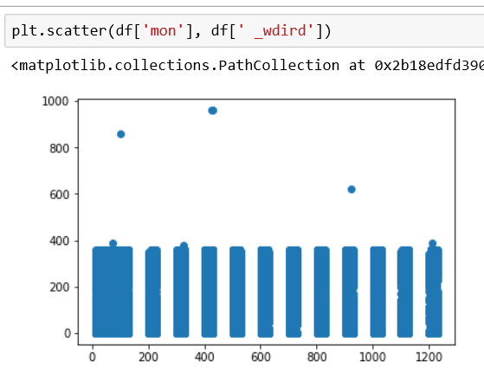
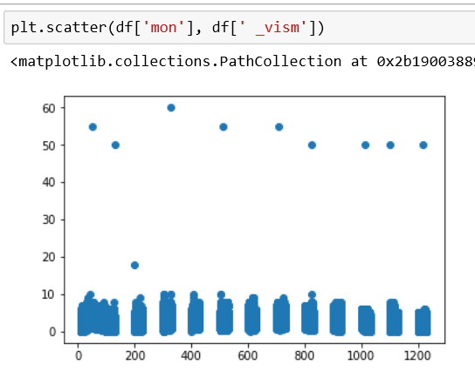
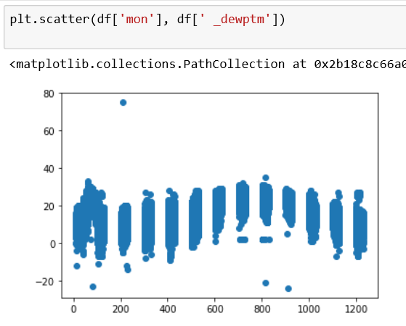
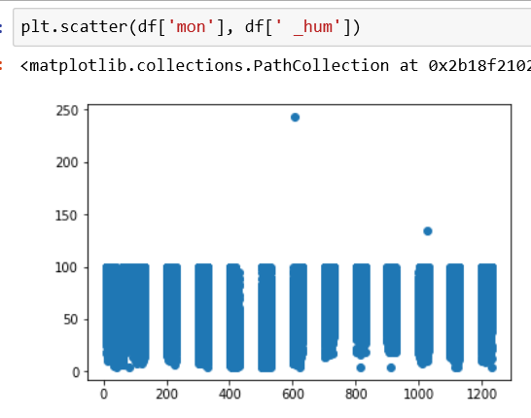
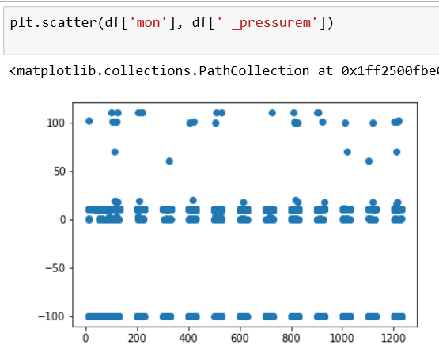
4.Plotting the scatter plots for every feature

Slide 7
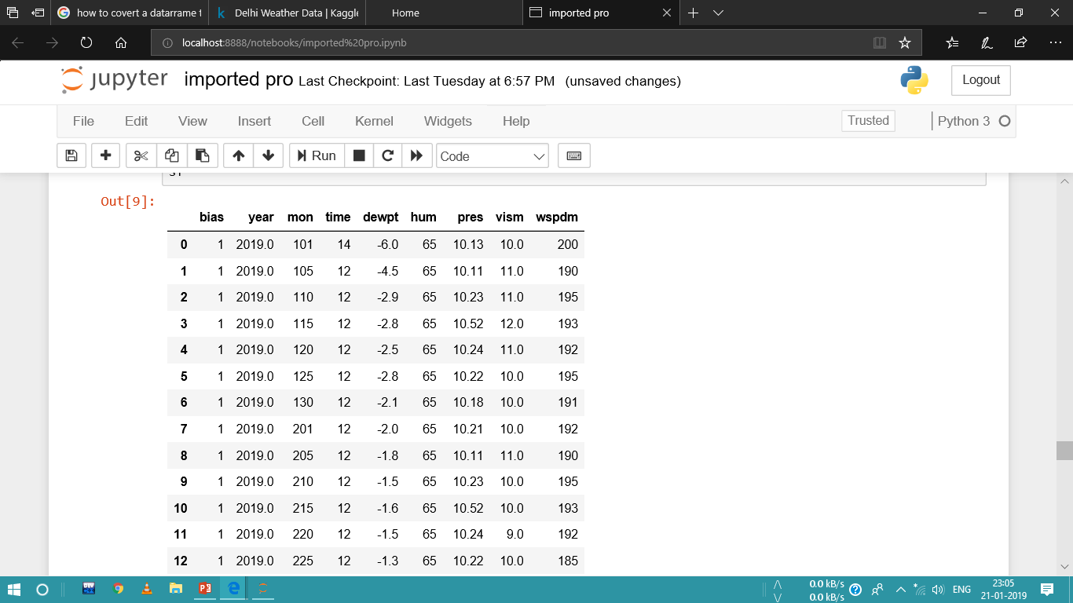
5.Building the dataset of 2019
Plotted scatter plot for each feature with months …
Observing the graphs tries to guess values for forthcoming year and predicted some values on the sample dataset for 2019 …

Slide 8
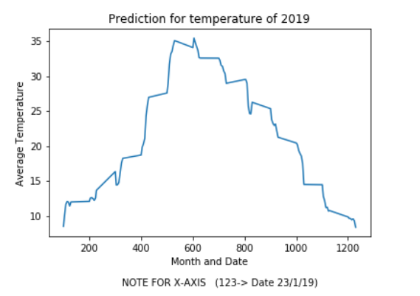
6.Prediction of average temperature for year 2019
Here are the results …..

Slide 9
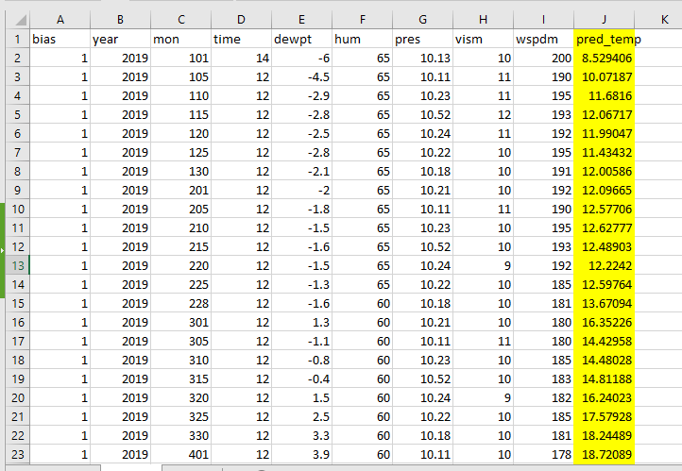
7.Saving the predicted temperatures
On Excel Workbook…

Slide 10
Thank You !!

